Slide 1
Ghidra Setup
Dr. Colin O’Flynn
ECED4406 – Dalhousie University

Slide 2
Step #1: Install Ghidra
Ghidra runs on Windows/Mac/Linux
I’ve only run on Windows – see installation instructions for other platforms.
On Windows – download the following which includes the Java runtime built-in:
https://github.com/colinoflynn/eced4406/releases/download/0.0/ghidra_9.1.2_PUBLIC_WITHJRE.zip

Slide 3
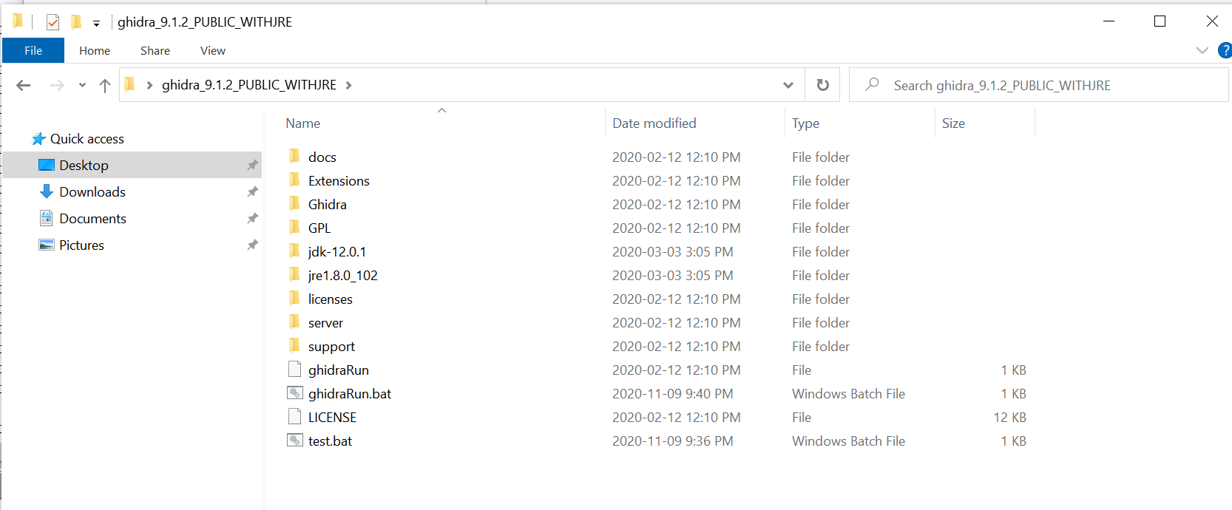
Step #1: Install Cont’d
Extract Ghidra somewhere

Slide 4
Running Install

Slide 5
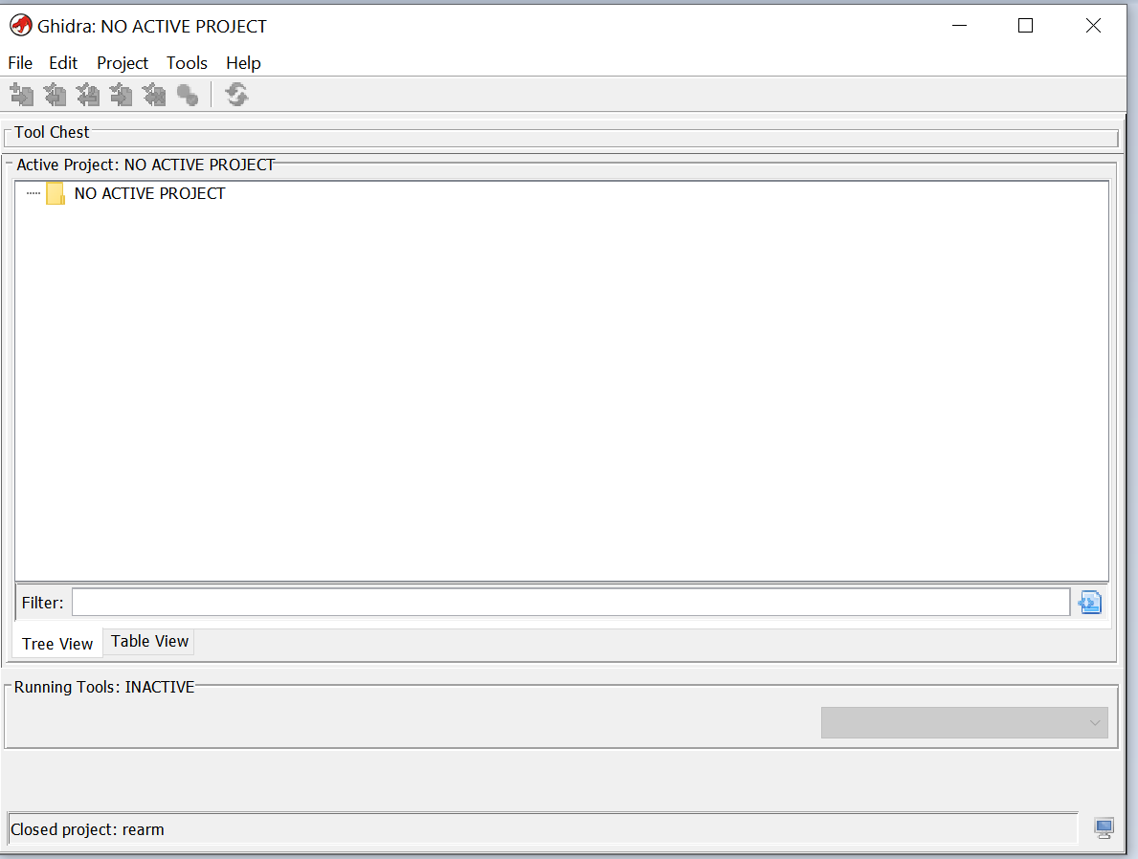
Step #1 Complete – Ghidra Online!

Slide 6
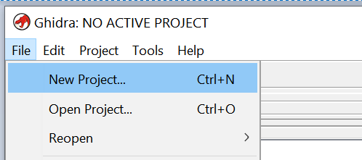
Step #2: Make a new project

Slide 7
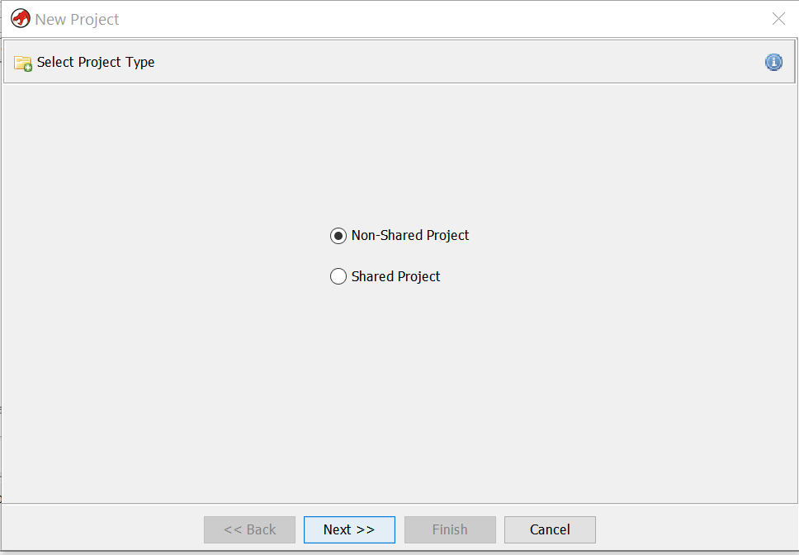

Slide 8
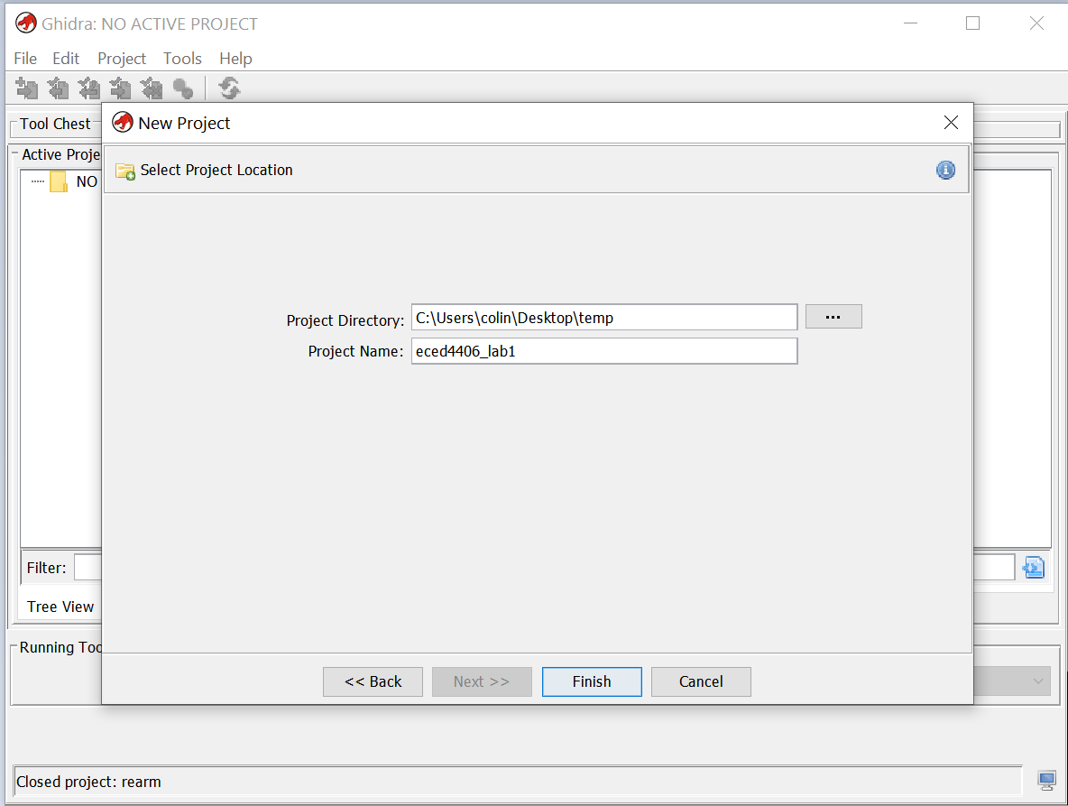

Slide 9
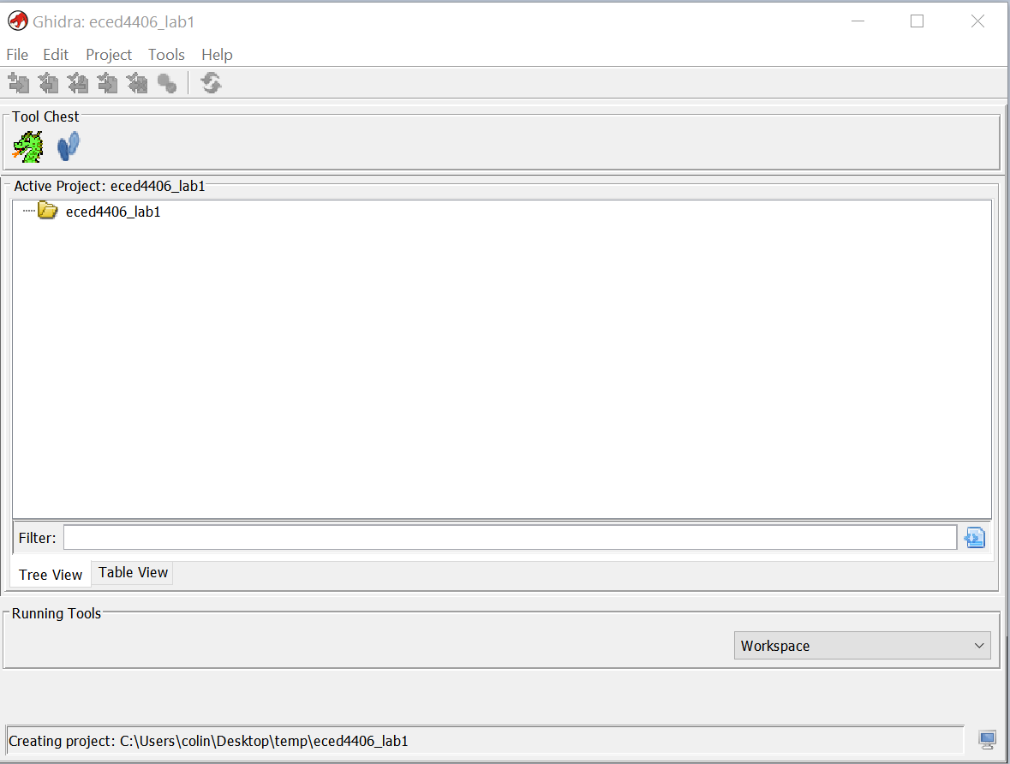

Slide 10
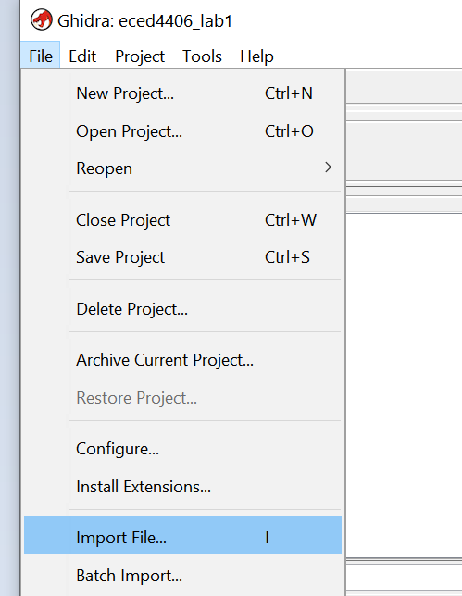
Step #3: Import file

Slide 11
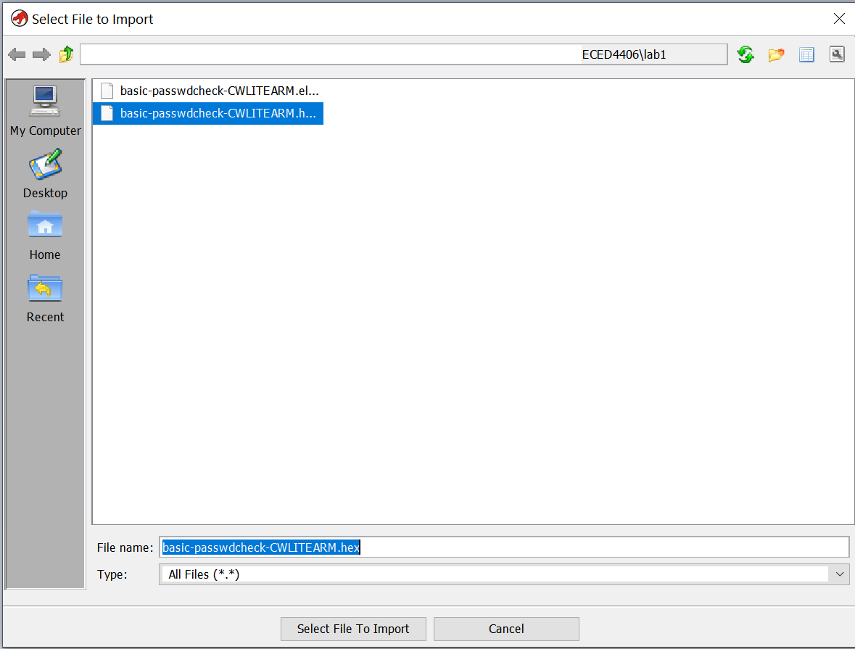

Slide 12
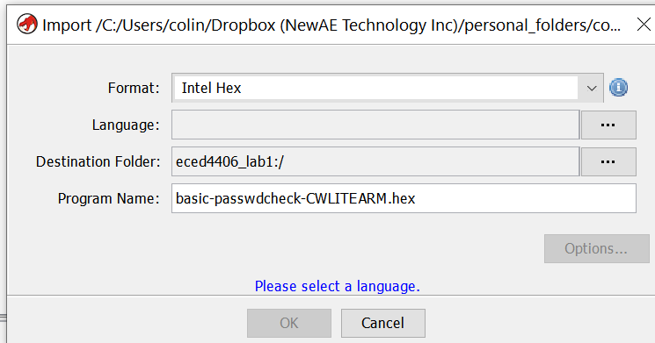

Slide 13
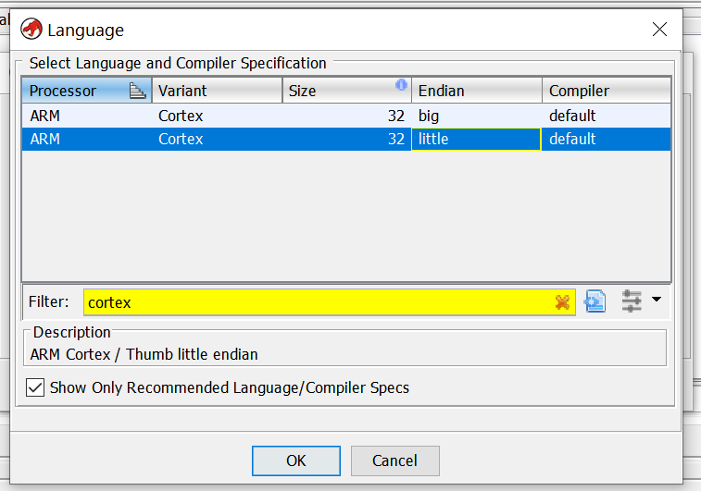
2. Select ‘little endian’
1. Type ‘cortex’

Slide 14
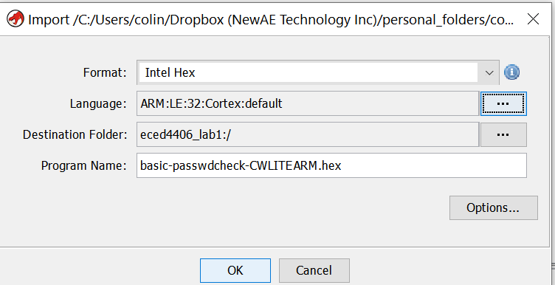

Slide 15
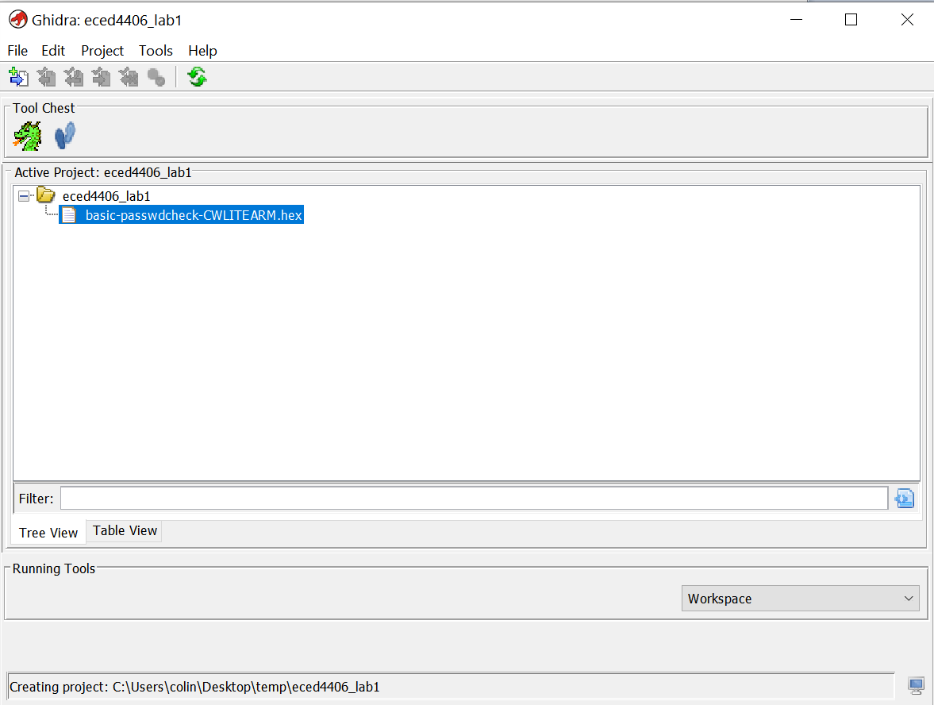
Double click on this

Slide 16
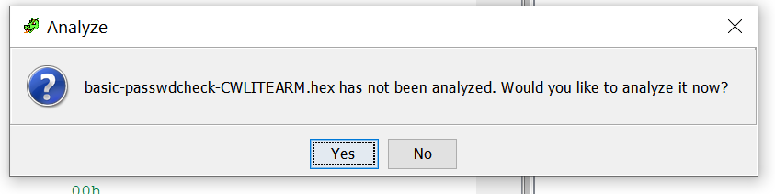

Slide 17
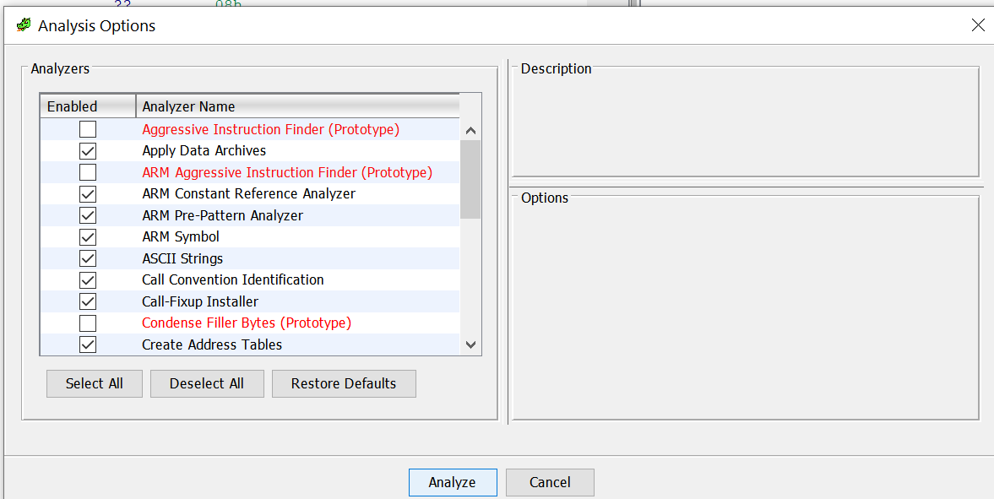

Slide 18
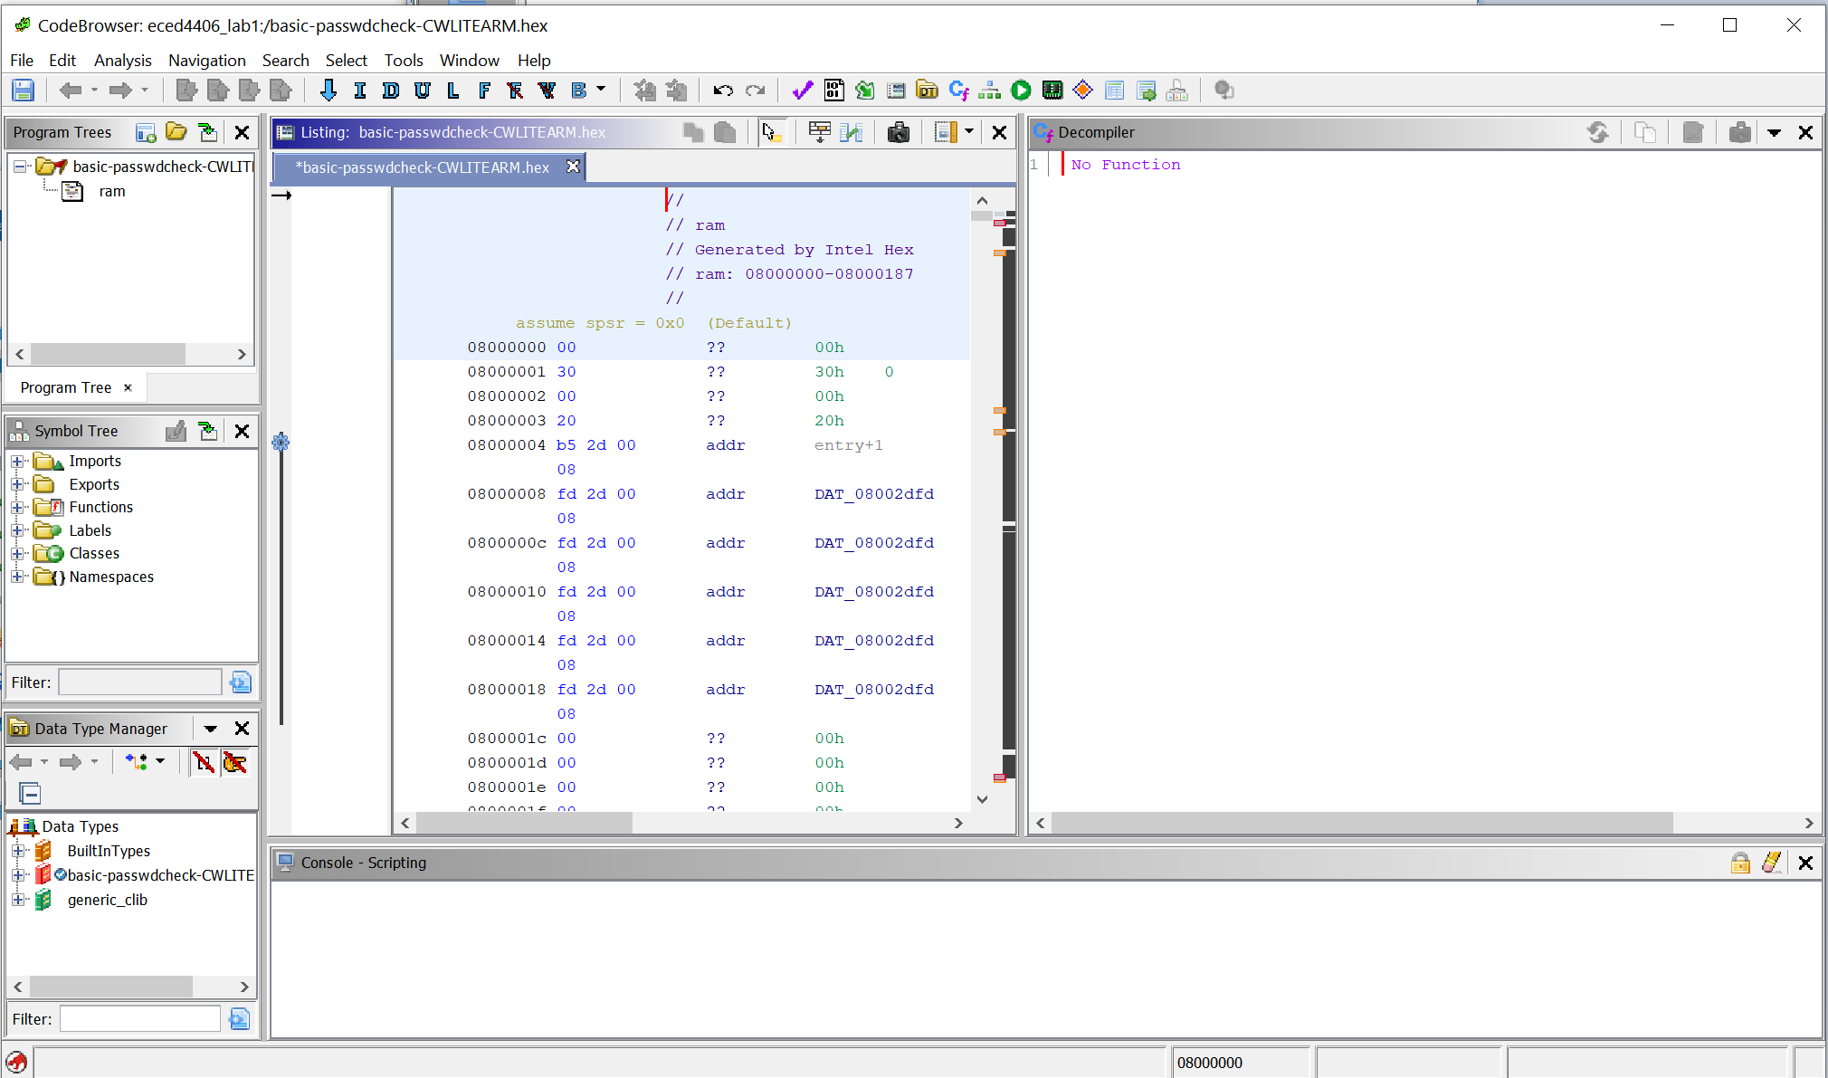
Done – file is now opened!

Slide 19
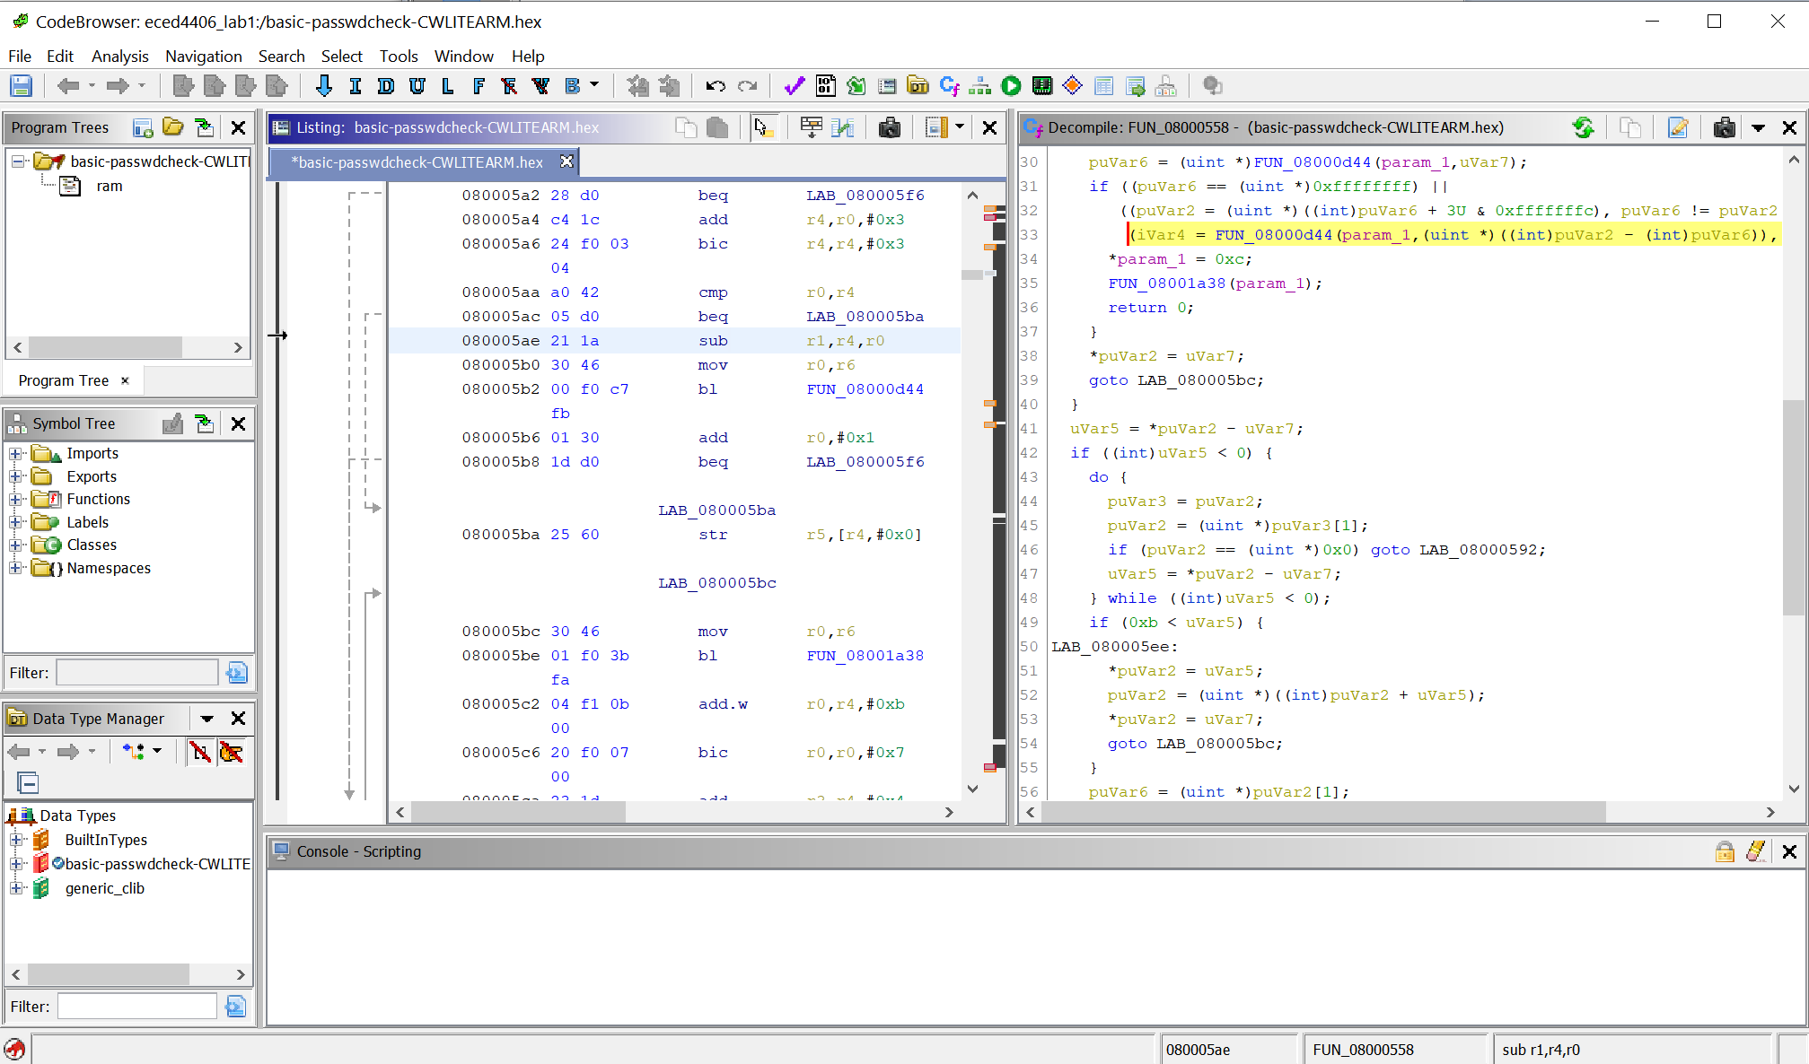
Explore disassembly on left → Decompiled on right

Slide 20
What is this source code??
Main file is:
https://github.com/newaetech/chipwhisperer/blob/develop/hardware/victims/firmware/basic-passwdcheck/basic-passwdcheck.c
..but also includes all the supporting code you “don’t see”, such as:
Low-layer hardware drivers (source elsewhere in link above).
Libraries linked in from compiler (source not in links above).

Slide 21
Next Steps
This was designed to confirm you can install & run Ghidra.
We opened a basic Arm Cortex-M binary.
Next – explore some features of Ghidra!

Slide 22

More Ghidra?
Several nice resources out there, such as:
Ghidra Ninja (Twitter / YouTube)
Hackaday Ghidra Course
Ghidra Book (https://nostarch.com/GhidraBook)

